Slide 1
Search Engine
multiple text File search engine in C++
Notes:
1

Slide 2
Contents Implementation via different techniques
Hash table using linked list
Hash table using vector storing frequency
Linear search algorithm using linked list
Red-Black Trees using maps storing frequency
Hash Table using Red-Black Trees storing frequency
Notes:
2

Slide 3
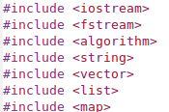

Defining preprocessors used
Libraries used (internal)
iostream for input/output
fstream input/output in/from a file
algorithms used for functions find(), count(),sort()
string for string datatype and string manipulation functions e.g. substr(), length() etc.
vector for vector datatype and functions
list for linked list
map used for map data structure (which uses Red-Black tree internally)
Preprocessor
if statement to find on which OS program is running.
Notes:
3

Slide 4

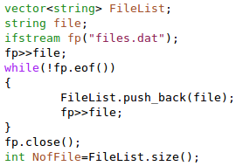
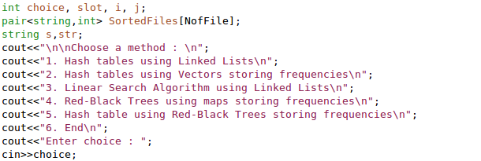
Documentation of main()
if statement checks OS then system command is used to list all the .txt files of the current directory in files.dat
FileList is vector of strings which stores the contents of files.dat
NofFile stores number of text files
pair<> datatype used to store names of files and word frequency
Options for user to choose algorithm to use
Notes:
4

Slide 5
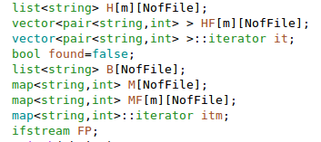
A matrix of list<string>(number of slots x number of files) is used to create Hash Table in the 1st case
A matrix of vector<pair<string,int>> is used to store the file name and the word frequency associated with it.
vector<pair<string,int>>::iterator it; is an iterator to these data types (similar to pointers).
map<string,int> is used to map strings to int (which uses Red Black Tree intermally)
Notes:
5

Slide 6
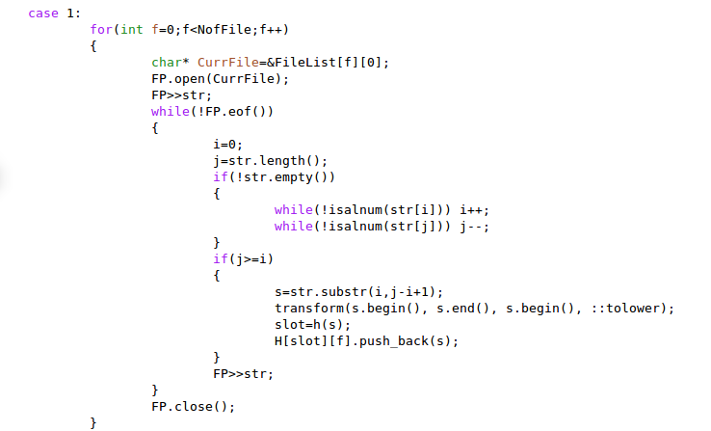
Case 1: Hash Table using Linked List:- We traverse the string from the start and the end till we encounter alphanumeric characters in order to get rid of punctuations if any. We take the valid substring and transform it in to lower case. Now we calculate the slot number by using hash function and push the string Then we read the next string
Notes:
6

Slide 7
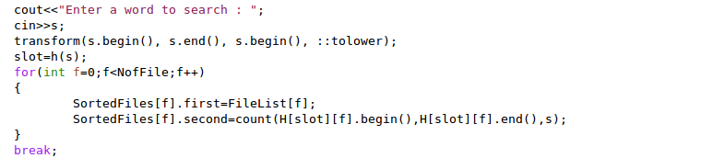
Case 1: Continued
Enter a word to search and transform that word to lower case. Calculate the slot number by using hash function. SortedFiles[f] is an array of pairs, we are storing the file number and the frequency of word in the pair.
Notes:
7

Slide 8
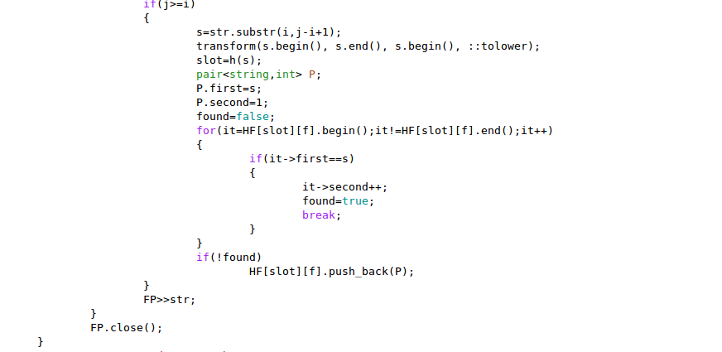
Case 2:
Extract a word from a file and if the word is already hashed then increment the frequency, if not found hash it and make the frequency 1 and repeat till the end of the file.
Notes:
8

Slide 9
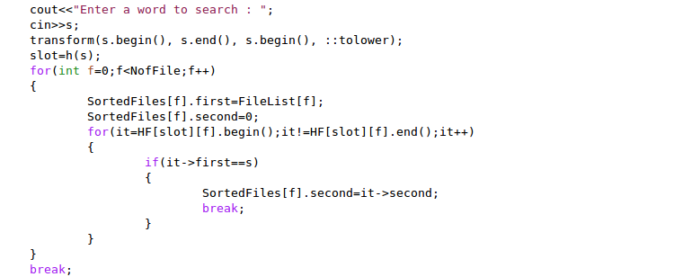
Case 2: Continued
Entered word is transformed to lower case and the hash slot number is calculated. In each file after the word is searched in the respective slot and the frequency is returned.
Notes:
9

Slide 10
Case 2: Continued
PROS
1. Insertion is θ(n*α/f) which is better than θ(n) of case 1. f is average
frequency of words.
2. Searching is O(α/f) which is better than θ(n) of case 1
3. Space complexity of case 2 is θ(α/f) better than θ(n) of first case.
4. As no pointers used so a constant but visible amount of space saved.
CONS
Case 5 is better than this case in all the three complexities.

Slide 11
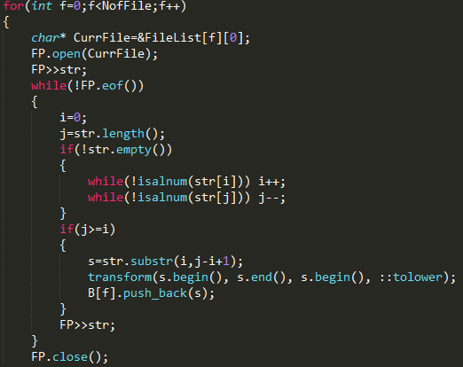
Case 3:
The file pointer extracts words one by one form
each file, which thenare converted to lowercase
and reduced to alpha-numeric form and inserted
in a linked list.

Slide 12
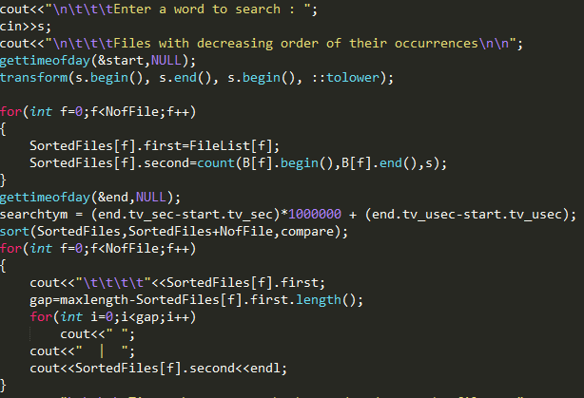
Case 3: Continued
The word to be searched is converted to
lowercase then it is searched in the list created
for this file. If found then frequency is then
known. Similarly for all files frequency of the
word is computed and stored. Then the files
are sorted accordingly and displayed.

Slide 13
Case 3: Continued
This is brute force method to search for a word in file.
Time complexity is θ(n) and space complexity is also θ(n).
The worst in all the cases.

Slide 14
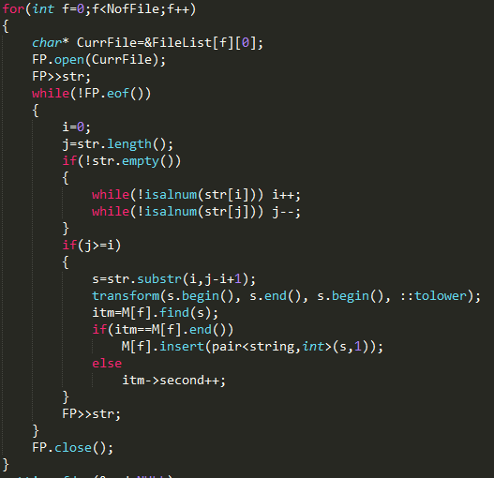
Case 4: Maps for each file
For each file the file pointer extracts a word(white space
separated ). The word is then reduced to alpha-numeric form
by removing non-alphanumeric characters. Then the
substring is reduced to lowercase then it is searched in the
map for that particular file. If the word is found then is
frequency is incremented by 1 else the word is added as a
new node to the balanced tree(map) . Then the same
procedure is followed till end of file is reached.

Slide 15
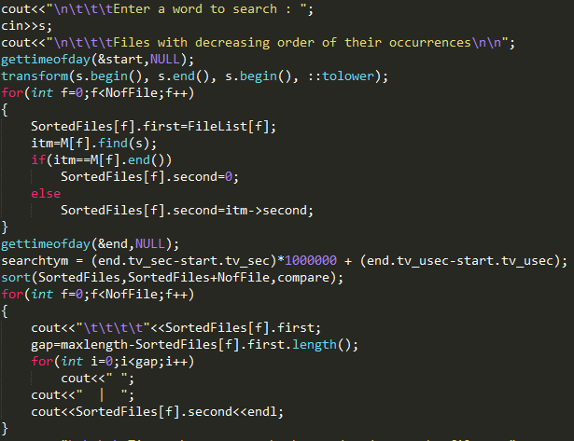
Case 4: continued
The word to be searched is entered, then it is
converted to lowercase and searched in the
map of the particular file. If found then its
Frequency is returned otherwise 0 is returned.
Similarly the frequency of the word in each file
is found and stored. And then the files are
sorted according to their frequencies.

Slide 16
Case 4: Pros and Cons
PROS:
Instead of linked lists maps(balanced tree) are used hence faster insertion and searching
of word.
CONS:
As one map per file is created so creation of initial data structure is time consuming.
A lot of memory is used as maps use a lot of pointers.

Slide 17
Case 5: Hash Table using Red Black Trees storing frequencies
There are two parts in this case
Building the Data Structure(Insertion)
Searching the Data Structure
Notes:
17

Slide 18
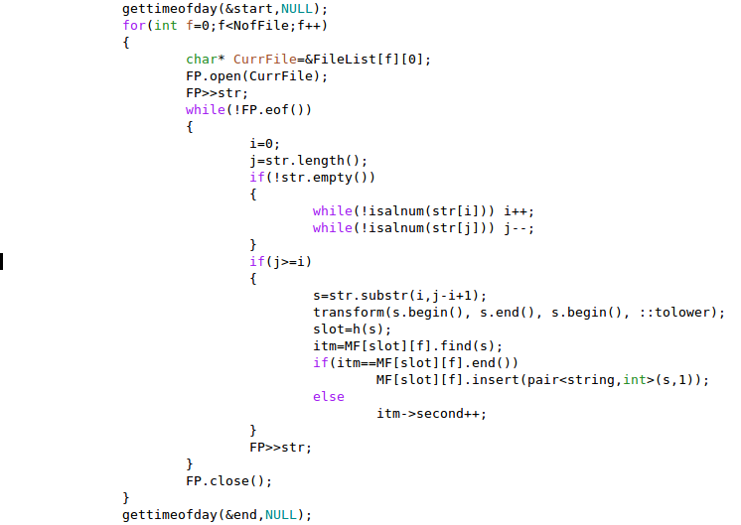
Building the Data Structure
The starting time is stored using object start of gettimeofday structure.
We traverse the string from the start and the end till we encounter alphanumeric characters in order to get rid of punctuations if any.
We take the valid substring and transform it in to lower case.
Slot number of the word is calculated.
We check if the word is already inserted in MF[slot][f].If yes, then we increment the frequency of the word or else we insert that word in MF[slot][f].
The finishing time is stored using object end of the gettimeofday structure.
Notes:
18

Slide 19
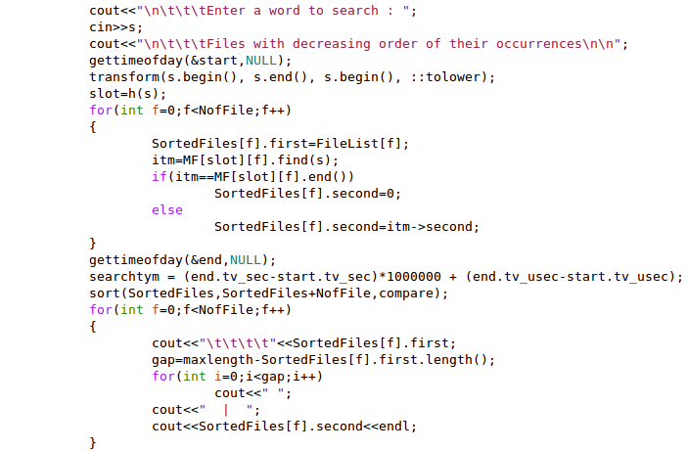
Searching the Data Structure
Enter a word to search
The starting time is stored using object end of gettimeofday structure.
Transform the word to lower case and calculate the slot number.
In each file search for the word in MF[slot][f] and store the frequency of word.
The file names are sorted on the basis of frequency of the word stored in each file.
The finishing time is stored using object end of gettimeofday structure.
Notes:
19

Slide 20
Asymptotic Analysis(Time and Space complexities)
Let m, F, f ,n be the number of slots, number of text files, total number of distinct words in the files and total number of words respectively.
Define α = n/(F x m), then α/f is the number of nodes in a Red Black Tree in each slot.
So for building the Data Structure, we take O(1) time to calculate the hash value(slot number) and O(log( α/f)) to insert the word in the Red Black tree for each word. So in total for n words building of Data Structure takes O(n log(α/f)) time.
For searching, first we need to calculate hash value(slot number) which takes O(1) time and then search the word in O(log(α/f)) time.(time required to search in a Red Black Tree).So Searching a word takes O(log(α/f)) time.
Space complexity is total number of nodes of Red Black Trees which is total number of distinct words which is O(n/f).
Notes:
20

Slide 21
Pros and Cons
Pros:
This algorithm reduces the building Data Structure time compared to case 4 by log(m).
This algorithm has best(fastest) searching time among all the five cases.
Cons:
This algorithm is n times slower in building the Data Structure compared to the case of building the Data Structure using normal Linked Lists.
Notes:
21

Slide 22
Why and When do we use Hash Tables?
Before understanding hash tables, let us understand the problems of a few simple data structures:
Arrays: Though arrays allow random access, they have a problem that their size is fixed.
Linked list: Linked lists have the advantage that their size can grow dynamically as they do not store elements contiguously. However where they do lack is in the random access to the elements. They require O(n) time to search any element.
Can we perform search in more efficient way than O(n) while still allowing the size to grow dynamically?
Hash tables do offer a solution to that. Hash tables are used when speedy insertion, deletion or searching is a necessity.
What are Hash Tables anyways?
A hash table is just an array coupled with a function known as hash function. Hash function takes an input called key and returns an integer known as the hash value as an output. The hash value maps the key to a particular index in the hash table. We initially use the hash function to determine where in the hash table do we store the key. Latter we use the same hash function to determine where in the hash table do we search for a given key. And hence hash function must be consistent and provide same hash value for identical keys.
Notes:
22

Slide 23
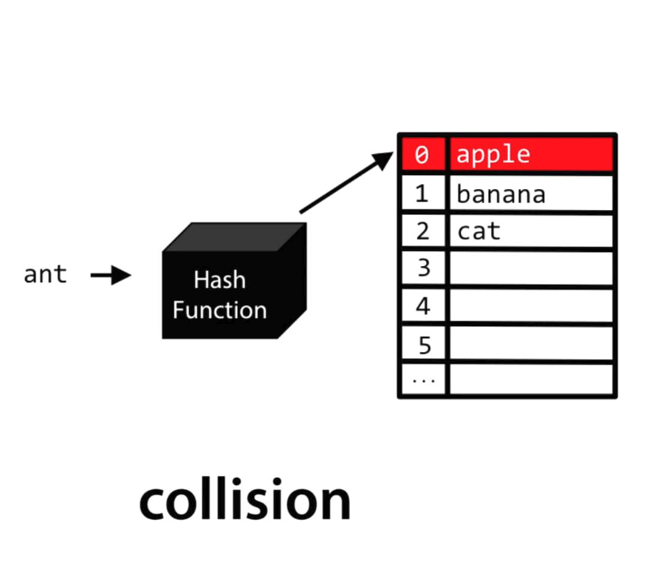
Collision problem can arise in Hash Table. We deal in this case either by probing method or by chaining method.
Consider the following example:
In linear probing we put ant in index 3 of the hash table. In chaining what we do is to make a linked list at each of the 26 indices. The hash table contains pointers to the first element of the linked list. Hence ant now becomes the second element of linked list which has it’s start pointer in the 0th index of hash table.
To avoid collisions which considerably slow down our search, we need to use good hash function. A few characteristics of a good hash function are:
Make use of all information provided by key.
Hash values are uniformly distributed across hash table.
Maps similar keys to very different hash values
Uses only simple operations.
Notes:
23

